Slide 1
Molecular Biology Biol 480
Lecture 7 January 23, 2019

Slide 2
Announcements/Assignments
Exam 1 ---Monday Feb. 4th.

Slide 3
Where were we…
DNA renaturation kinetics
DNA hybridization techniques
Determining DNA size---either molecular weight or number of base pairs

Slide 4
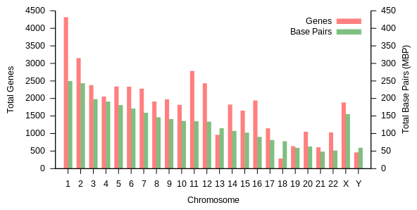
Human chromosomes
Millions of base pairs
http://en.wikipedia.org/wiki/Human_genome

Slide 5
Measuring DNA size
Early molecular biologists relied on centrifugal force to “settle” molecules present in a solution.
Centrifugation can be used to collect substances with densities greater than the solvent. Many techniques have been used to allow one to separate Nucleic acid molecules of different size by using solutions of different densities.
Sometimes referred to as sedimentation analysis

Slide 6
Purification and analysis of DNA after sedimentation involved many subsequent steps and other methods are used more often now. (You did this today!)
Nevertheless…you read of molecules described by a sedimentation measure (Svedberg units) used to describe nucleic acids (RNA) and proteins.
18S ribosomal RNA
80S ribosomal subunit

Slide 7
Ribosomal RNA is still described as “s” size

Slide 8
Early techniques for purifying DNA often used a sedimentation solution. DNA was centrifuged through a solution of known density or through a solution of varying density—known as a density gradient. DNA molecules of different size would sediment to their corresponding density.
Cesium Chloride was commonly used for this type of purification

Slide 9
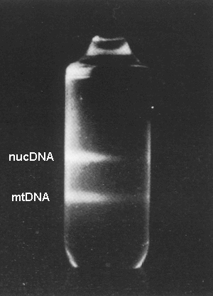
Centrifugal force

Slide 10
In the years just before I was in graduate school, plasmid purification would have involved separation by centrifugation in centrifuges bigger than a washing machine, fairly nasty chemicals, and several days of work.
You did the same this morning—without nasty chemicals, in a couple of hours. ☺

Slide 11
Electrophoresis of Nucleic acids
Figure 10-20
More modern/common way of separating nucleic acids—usually fragments of a DNA.
Migration through a porous matrix via electrical attraction
Size and charge dependent
DNA migrates toward a positive pole in an electrical field. Migration is inversely proportional to the length of the DNA molecule.

Slide 12
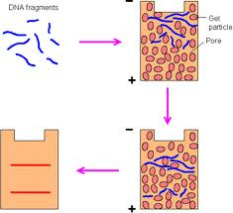
Agarose Gel electrophoresis

Slide 13
Range of applications
Depending on the application, different gels are used which have different pore sizes.
Electrophoresis can be used to separate whole chromosomes (a technique called pulsed gel field electrophoresis)
Electrophoresis can resolve/separate DNA fragments of 100s-1000s of bases in size.
Electrophoresis can even separate DNA that differs by only in a single nucleotide (100 vs. 101 nucleotides in length)

Slide 14
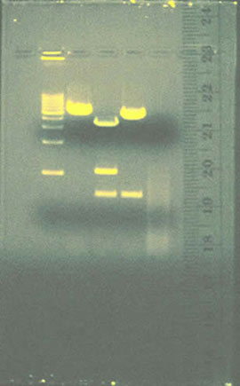
Standard electrophoresis—agarose gel

Slide 15
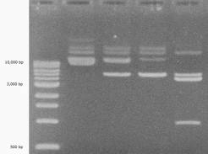

Slide 16
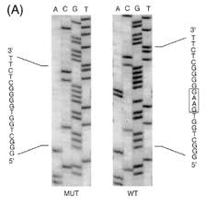
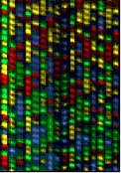
Electrophoresis is the basic technique behind sequencing of genomes.

Slide 17
The gel used in sequencing, resolves single nucleotides! Each fragment is only 1 nucleotide longer than the previous one.
We will learn more about the technology soon.

Slide 18
Let’s continue to look at DNA—What is its nature in cells?
Topics in chapter 12/supplemental material
Chemists think of DNA as a…chemical! The plasmid DNA you purified in lab would behave in a predictable manner, based on the atoms that make it up.
e.g. It exhibits a negative charge; one can separate it using electrophoresis.

Slide 19
Biologists would refer to this as “naked” DNA.
Cells (prokaryotic and eukaryotic), viruses, and organelles like mitochondria and chloroplasts contain DNA in the form of chromosomes.
There is a level of organization associated with DNA in living things, that distinguishes it from DNA the chemical deoxyribonucleic acid.

Slide 20
Features of chromosomes
Bacteria, viruses, and organelle genomes are usually relatively small, circular DNA molecules.
Some viruses have RNA genomes—either single or double stranded RNA
Some viruses have linear DNA molecules

Slide 21
The genomes of bacteria, eukaryotic cells, and viruses are never extended double helices. They show extensive folding and compaction to allow them to fit inside a cell membrane or protein coat.

Slide 22
Prokaryotes and viruses
Chromosomal DNA/RNA associate with some proteins, but not as much as we see in eukaryotic chromosomes.
E.g. in bacteria, 3 proteins, HU, and H-NS, IHF bind to the DNA and facilitate formation of structure. (Help bend and fold the chromosome)
These proteins are positively charged so the interaction of the DNA and protein occurs via ionic/electrostatic bonds.
The proteins likely affect gene expression too.

Slide 23
Supercoiling
Circular DNA like bacterial chromosomes and plasmids have special forms that are the result of being a circle---not having free “ends”. The DNA helix may itself be further twisted---a phenomenon called supercoiling.
We discussed this phenomena today!

Slide 24
DNA topology
Supercoiling is a mechanism for closed circular DNA to maintain base pairing if the helical turns are altered.
Let’s study figure 12-4. Read about how supercoiling was noticed using electrophoresis.

Slide 25
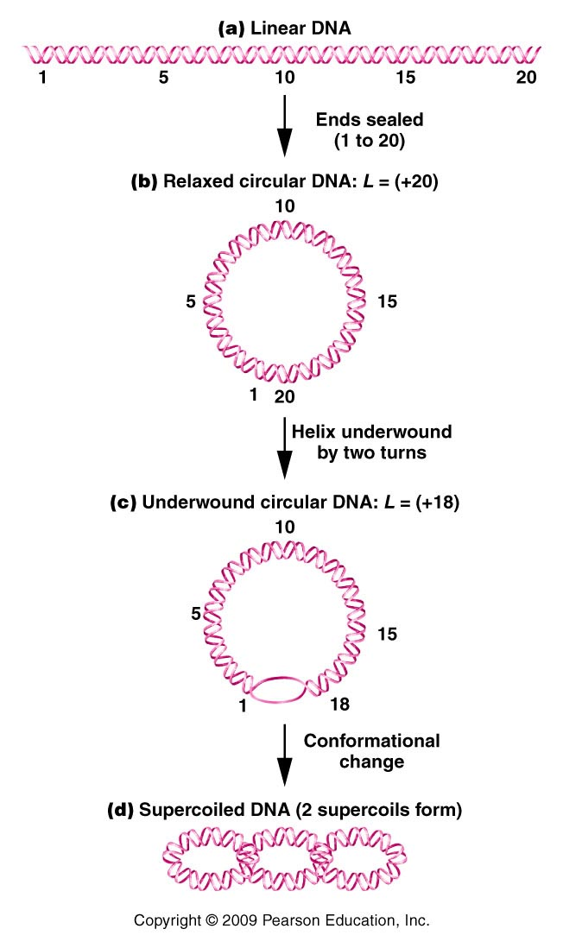
Figure 12.4
Notes:
Figure 12-4 Depictions of the transformations leading to the supercoiling of circular DNA. L equals the linking number.

Slide 26
Linking number
L=linking number describes the number of helical turns in a circular DNA molecule.
What do you need to know to calculate this?

Slide 27
Circular DNA molecules are unable to “flex” or rotate freely.
They tend to be underwound at points putting stress on the molecule
Figure 12.4
Notes:
Figure 12-4 Depictions of the transformations leading to the supercoiling of circular DNA. L equals the linking number.

Slide 28
Supercoiling actually relieves the physical stress on the DNA molecule caused by underwinding.
Since the DNA twists go in the opposite direction as the DNA helix turns, these are known as negative super coils.

Slide 29
Underwinding reduces the expected linking number (based on the number of nucleotides).
For example, a virus, SV40, has a chromosome of 5200 bp, but only 475 helical turns. (how many are expected?)
5200bp/10.4 turns per bp =500 turns (expected)

Slide 30
Only 475 turns are present. (the molecule is underwound)
25 negative supercoils form in the chromosome to relieve the stress caused by underwinding.

Slide 31
Changes in linking number in a DNA molecule are not a spontaneous event. In a circular molecule DNA must be temporarily cut and quickly rejoined to alter the number of helical turns.
Enzymes called topoisomerases, facilitate these activities.

Slide 32
2 types of topoisomerases exist.
Type I---cut one strand allow rotation of the molecule and reseals the phosphodiester bond. This reduces negative supercoils in DNA.
Type II-cuts both strands, allows passage of of both strands through a double-strand region and reseals both phosphodiester bonds. This decreases linking number and introduces negative supercoils.

Slide 33
Topoisomerases are essential in the unlinking of the 2 circular molecules of DNA that form after DNA replication in prokaryotes.
Called Decatenation

Slide 34
DNA in eukaryotes is in the form of linear chromosomes. Since linear chromosomes have free ends, you might think that supercoiling would not occur.
But in cells the eukaryotic DNA is highly complexed with proteins and contains regional, anchored sections, similar to circular DNA molecules, that show extensive supercoiling.

Slide 35
Eukaryotes have type I and type II topoiosmerases as well.
These enzymes are essential in several processes in cells that cause the DNA to be over or underwound---including DNA replication and transcription.

Slide 36
Their essential role in cells have made topoisomerases a good target for drugs used to kill cells---such as cancer cells.
One class of chemotherapy agents target topoisomerases. Inhibiting topoisomerase activity leads to broken DNA molecules, which eventually induces apoptosis in the cell.

Slide 37
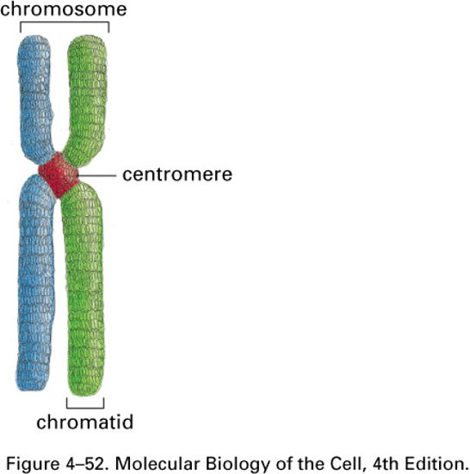
Eukaryotic chromosomes
DNA associates with Histone proteins to form chromosomes. Loosely analogous to spooling of thread and the stacking of spools, and the looping of stacked spools!

Slide 38
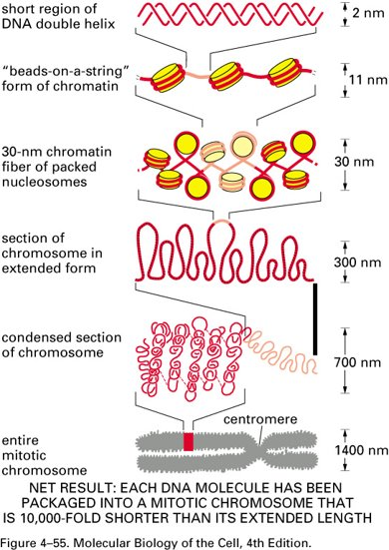
Dynamic structure—DNA organization

